Slide 1
The Importance of Bar Models

Slide 2
Session Contents
What are ‘bar models’?
How can bar models be used in different year groups?

Slide 3
What Are Bar Models?
Whole
16
10
6
Part
10
16
6

Slide 4
A Consistent Picture
4 + 11 = ?
15 - 4 = ?
?
15
4
11
4
?

Slide 5
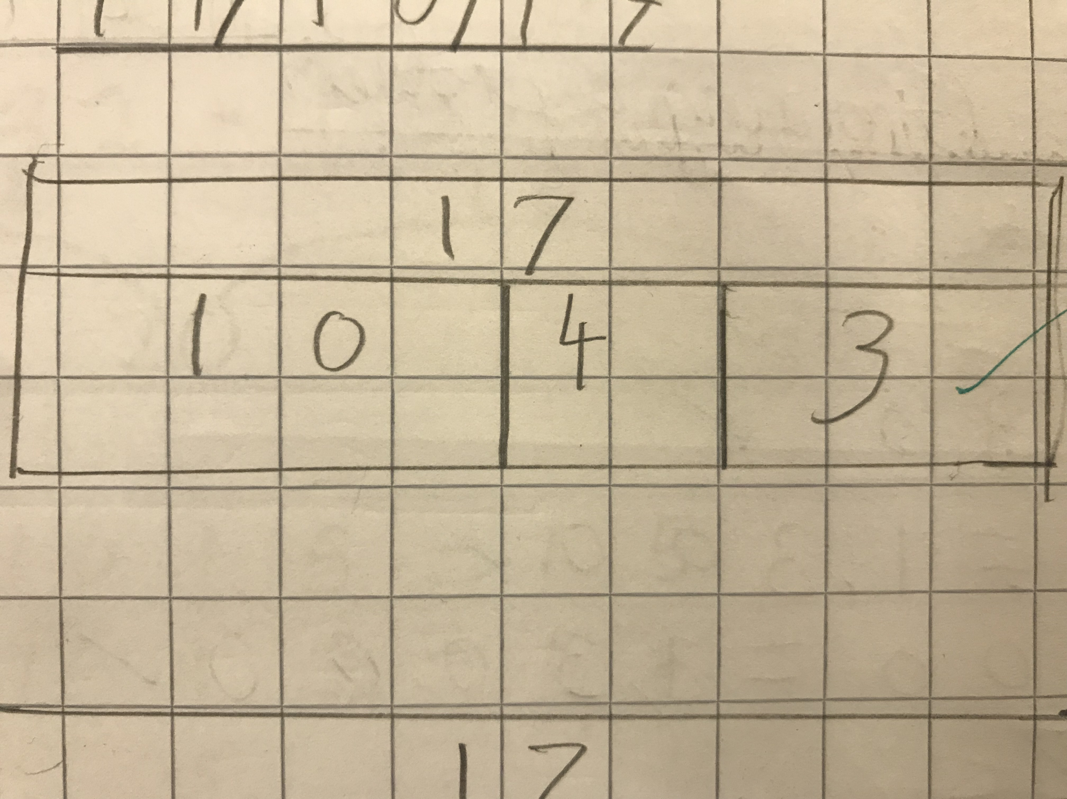
Bar modelling in Year 3
Used for addition.
This can be extended to larger numbers, for example, having a block of hundreds

Slide 6
A Consistent Picture
5 x 4 = ?
20 ÷ 5 = ?
?
20
4
4
4
4
4
?
?
?
?
?

Slide 7
A Consistent Picture
2 of 20 = ?
Share 20 in the ratio 2:3
5
20
20
?
?
?

Slide 8
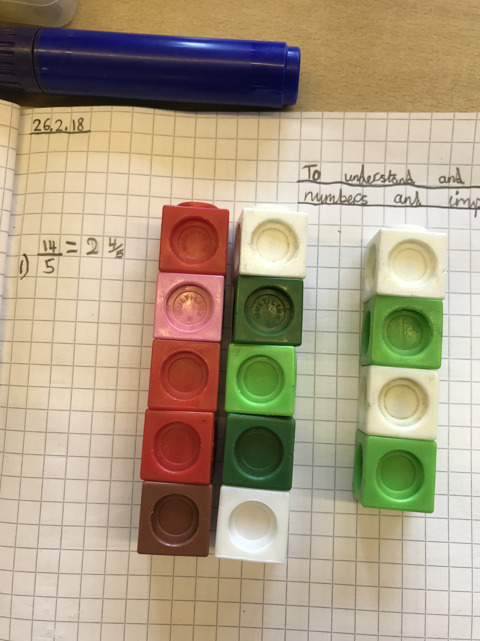
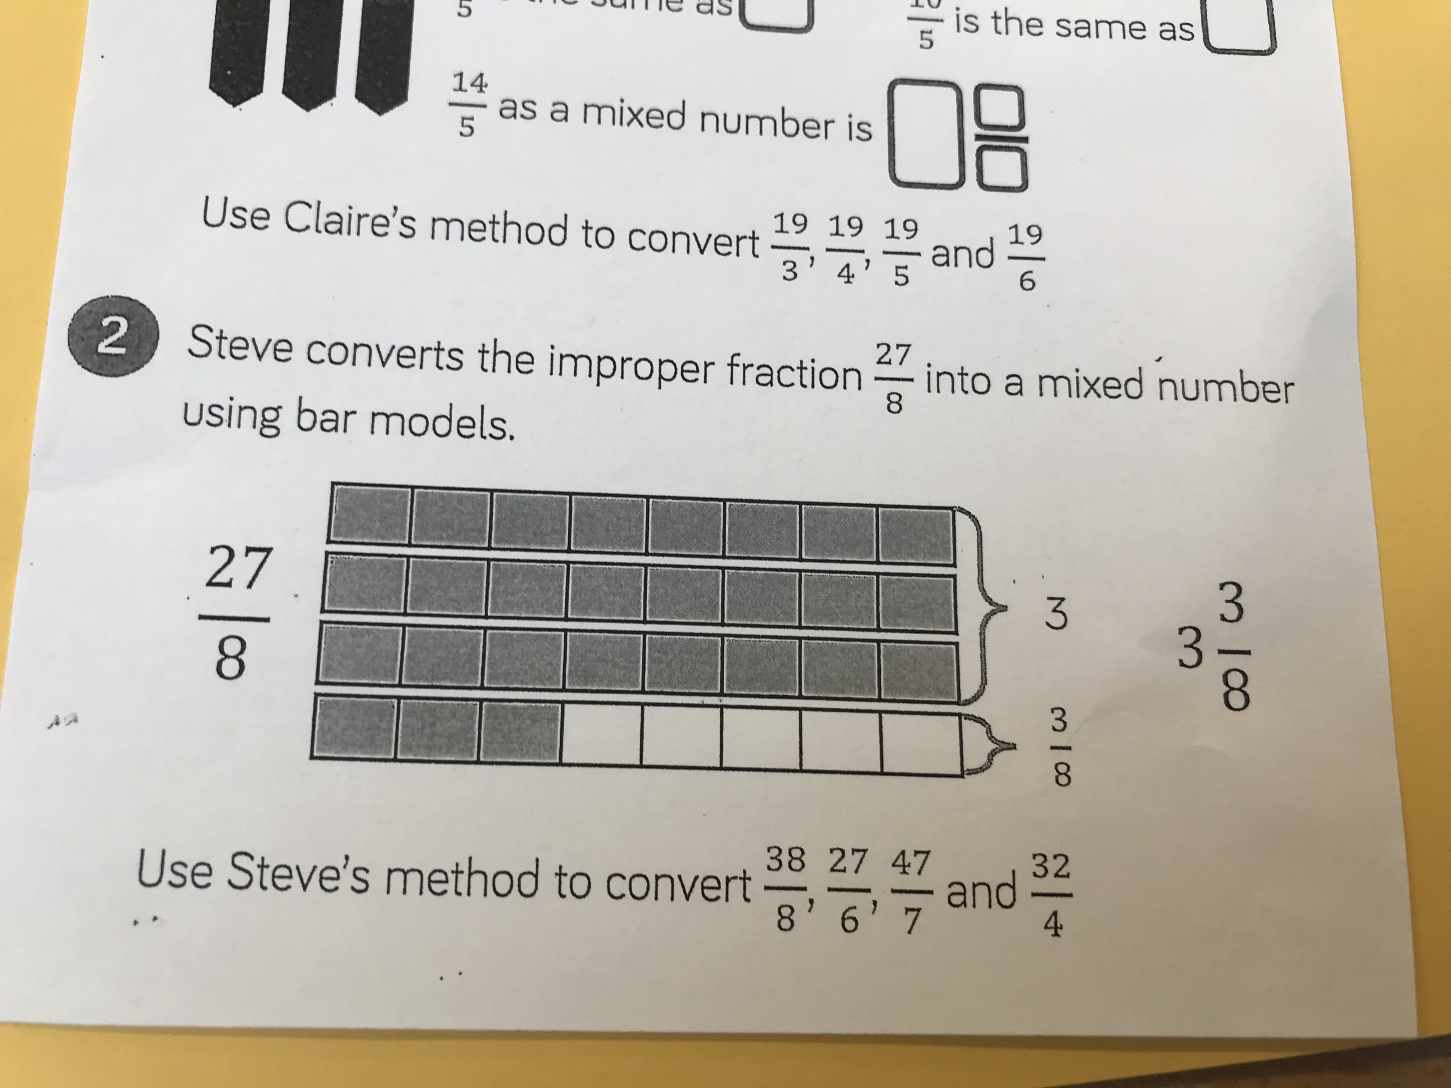
Upper KS2 Bar Modelling
Example of work completed in Year 5

Slide 9
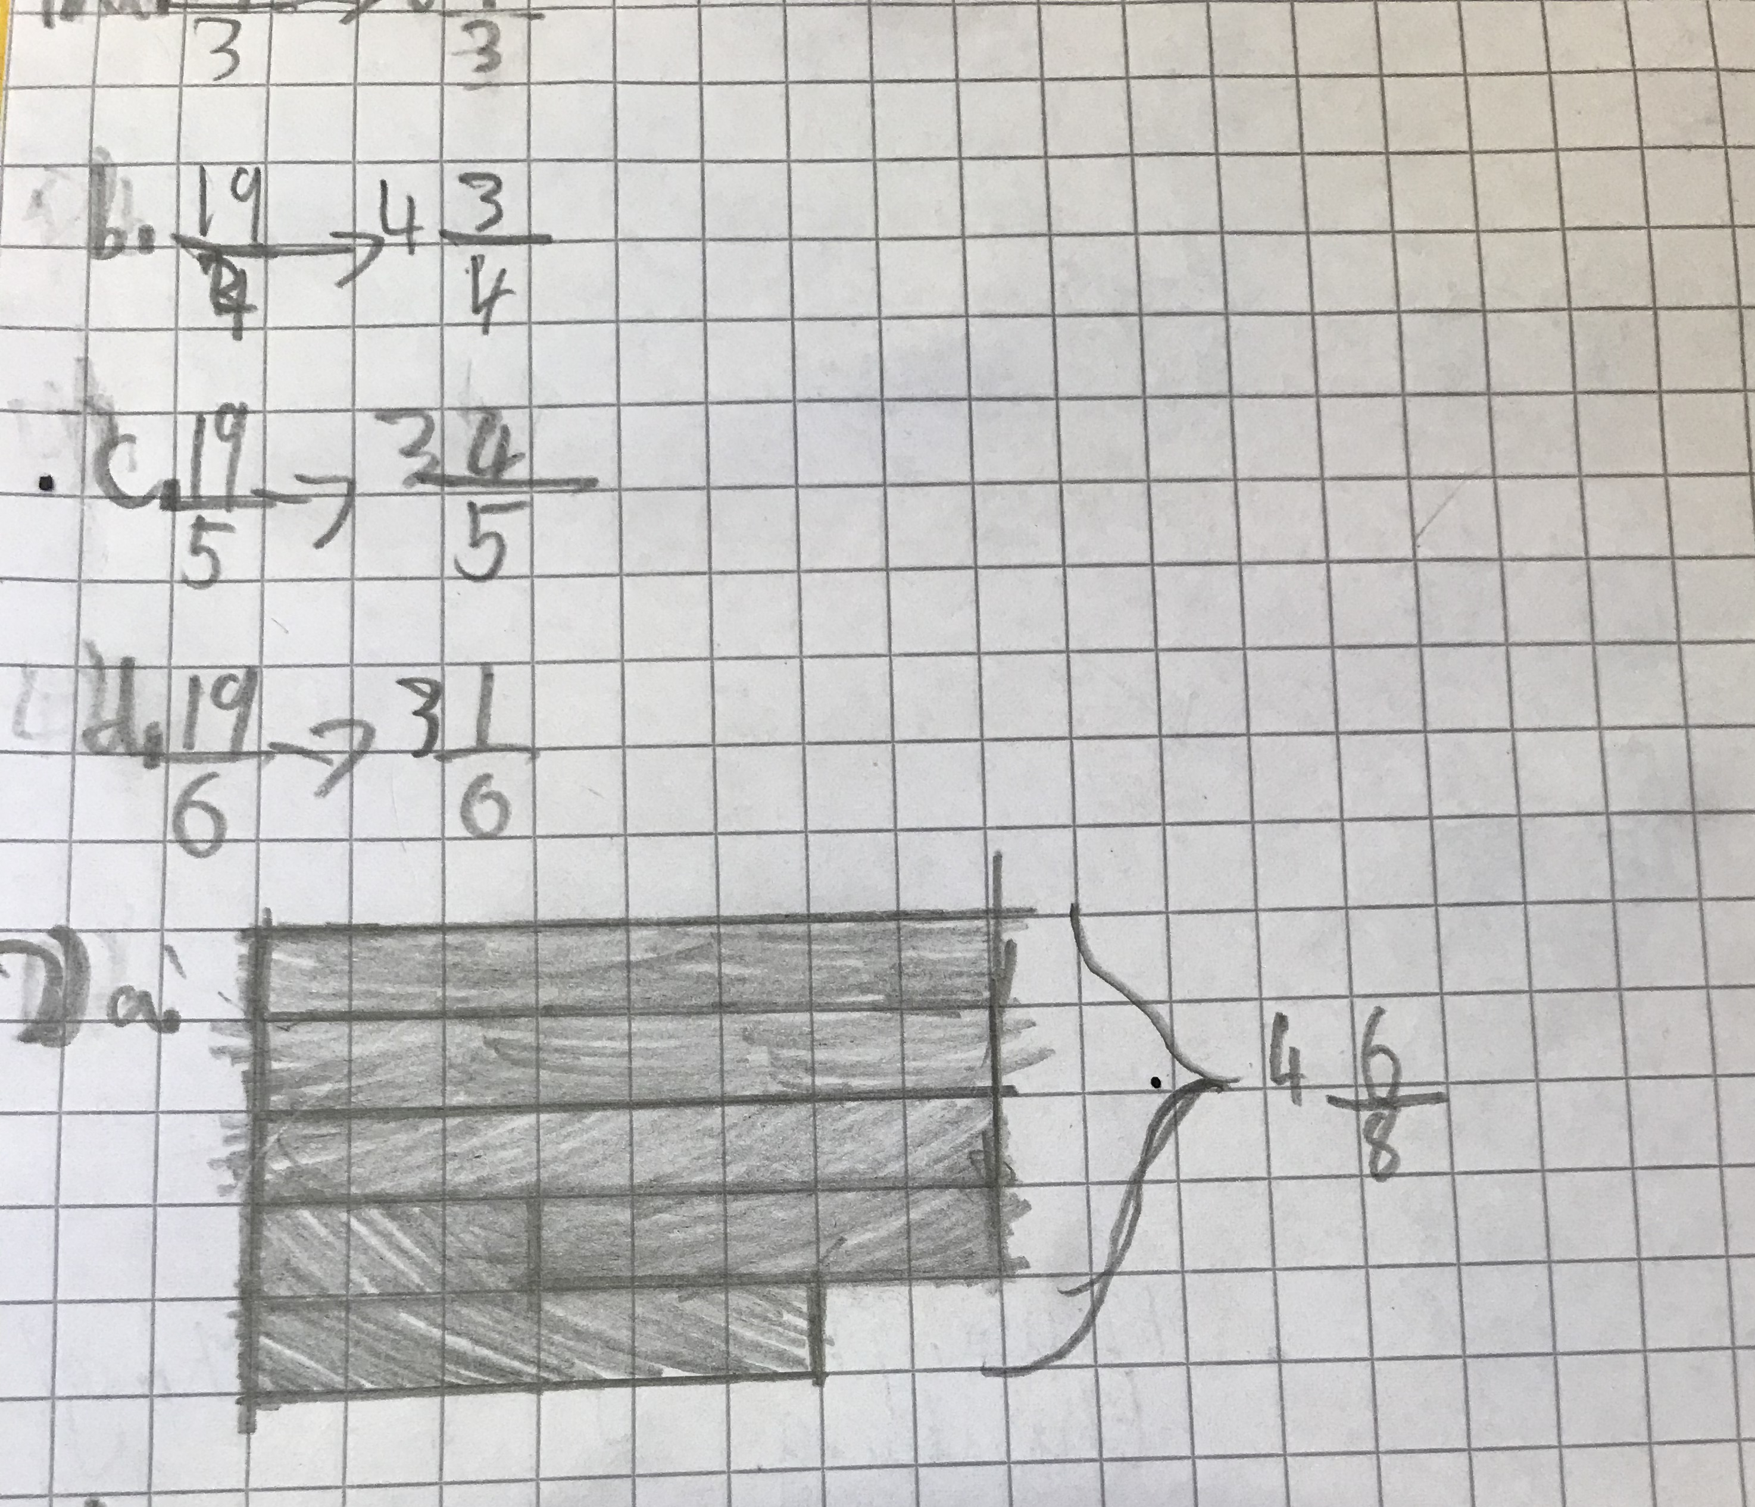
Fractions Bar Modelling
Solved using cubes (concrete)
Solved visually (pictorially)

Slide 10
Bar Modelling to show equivalent fractions

Slide 11
KS2 Bar Modelling
Solve… Matthew has a 300g block of cheese. He eats $\frac{2}{5}$ of the cheese and puts the rest back in the fridge.
How much cheese did Matthew put back in the fridge?
300g
Calculations
300 ÷ 5 =
60
60
60
60
60
60
3 x 60 = 180
Eats
Put back
?
180

Slide 12
Algebra Bar Modelling
3a + 4 = a + 8
Model
Calculations
3a
+ 4
=
a + 8
a
a
a
4
-a
-a
2a + 4 = 8
a
8
-4 -4
4
2a = 4
÷2 ÷2
a = 2

Slide 13
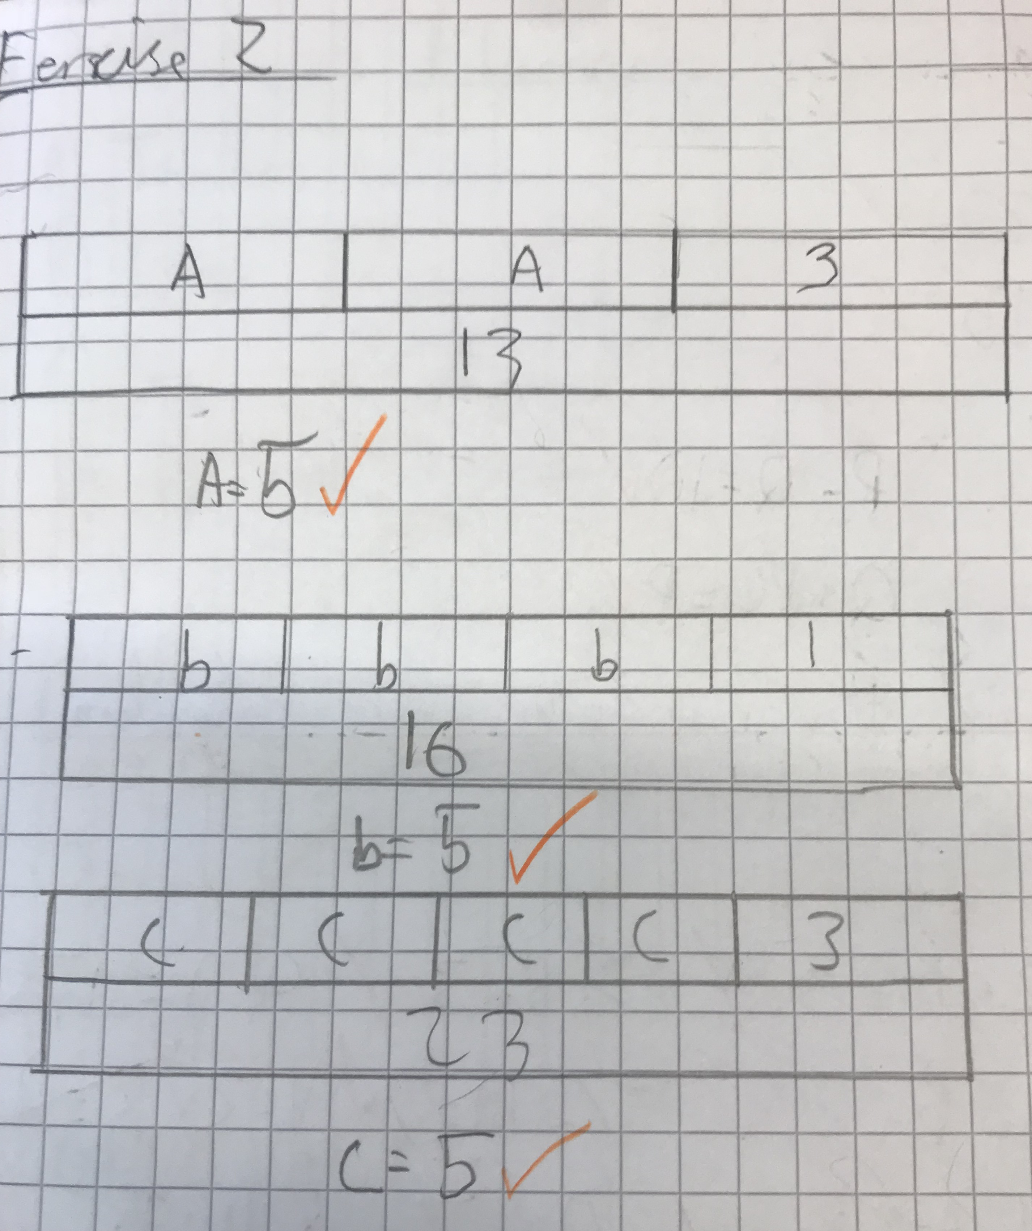
Algebra Bar Modelling- Year 6

Slide 14
Solve 2a + 3 = a + 7
2a + 3 = a + 7
a
a
3
-a
-a
a + 3 = 7
-3
-3
a
7
4
a = 4

Slide 15
When is Bar Modelling useful?
Visual addition and subtraction
Partitioning numbers
Lots of/groups of when multiplying and dividing
Finding ‘parts’ of a whole number
Finding fractions of amounts
Visual representations of algebra
Ratio and proportion

