Slide 1
Using concrete resources in Maths
Why is it important to use concrete resources with all children?
How are these resources used in the classroom?

Slide 2
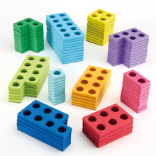
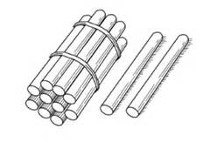
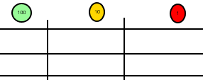
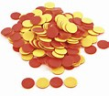
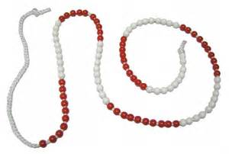
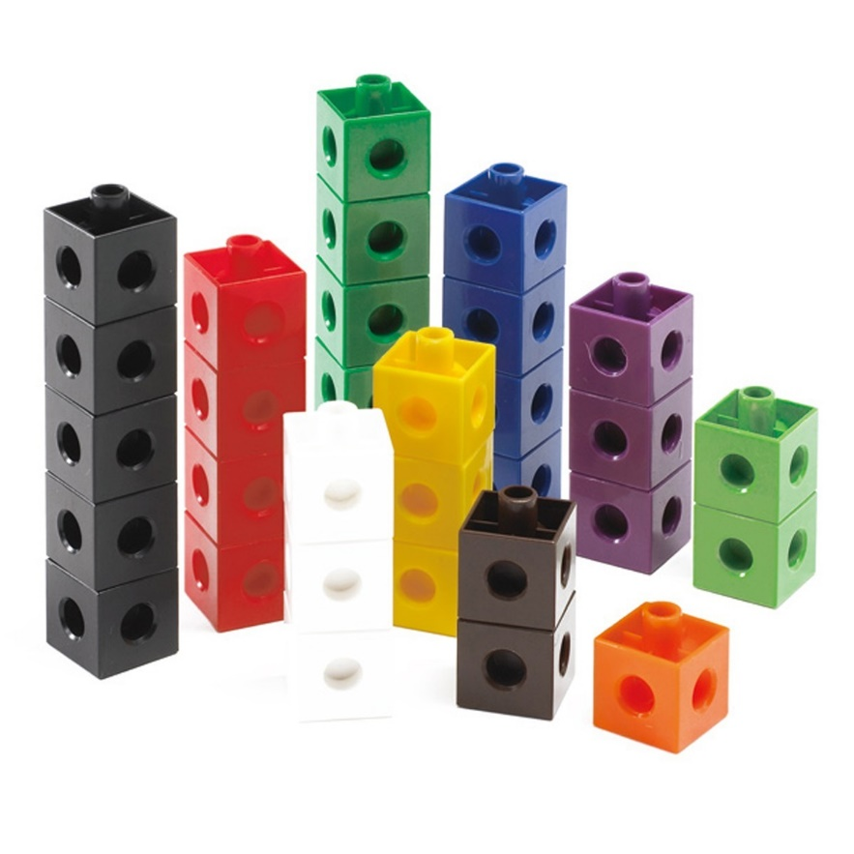
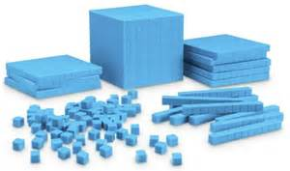
A range of resources

Slide 3
Why is using concrete resources important?
It gives children a deep understanding of Maths
Concrete resources give time pupils to investigate a concept first - and then make connections when formal methods are introduced

Slide 4
5000 ÷ 100 =
Explain what you have to do in order to answer this problem. Can you think of a rule for dividing whole numbers by 100.

Slide 5
5 ÷ 1000 =
3.2 x100 =
0.09 x 1000 =
4.4 ÷ 10 =
60 ÷ 100 =

Slide 6
Using concrete resources with fractions
1/3 x 5 =
2/6 x 2 =
¾ of 12 =
Can you think of another question that will give the same answer and represent your question using multi-link?

Slide 7
What’s in the cup?
How can we represent the cups and counters?
Model
Calculations
2c + 2 = c + 5
c
c
-2
-2
2c = c + 3
-c
-c
c
c = 3
Notes:
How could this KS3 content be adapted for KS2? (Example: pupils could be asked to solve 2c + 4 = 14)
Could cups and counters be used anywhere in the KS1 curriculum (eg finding the missing digit in a problem)? Pupils could have 10 counters and 2 cups, their partner must hide some counters in the cup and show some. They must write down the calculation 10 = 7 + __ and identify the missing digit.

